Slide 1
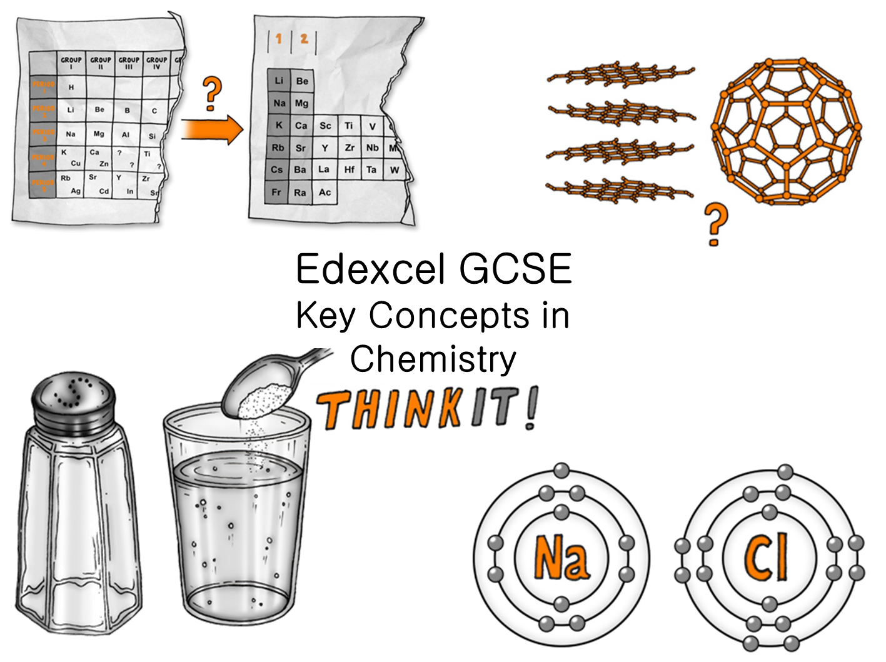
© Copyright The PiXL Club Ltd, 2017

Slide 2
The development of the atomic model:
Explain how the discovery of the electron led to Thomson’s plum pudding model.
Describe Geiger and Marsden’s scattering experiment and explain how the results disputed the plum pudding model.
Explain Niels Bohr’s version of the atom.
Atomic structure:
Compare the radius of the nucleus to the radius of the atom.
In terms of particles, explain the relationship between two isotopes of the same element and explain why these isotopes have identical chemical properties.
It is impossible for an atom to have a mass of 35.5. Explain why this is the quoted mass for Cl in the periodic table.
The periodic table:
How would you explain the structure of the modern periodic table to John Newlands?
Explain how Dmitri Mendeleev used atomic weights to construct his periodic table and explain why scientists came to believe Mendeleev's periodic table.
Explain how the position of an element in the periodic table is related to the arrangement of electrons in its atoms.
Describe how to calculate an element’s electronic structure.
Covalent Bonding:
Nitrogen gas is a diatomic molecule. Explain how the atoms are joined together.
Explain why the melting point of hydrogen chloride is -115°C, whereas sodium chloride’s melting point is 801°C.
Sulphur hexafluoride SF₆ is an insulating gas. Suggest the type of bonding present and explain why it is gaseous at STP (Standard Temperature and Pressure).
Edexcel GCSE Key Concepts in Chemistry
ThinkIT!
Properties of Ionic compounds:
NaCl has a very high melting point, but can be easily crushed. Use your knowledge of bonding to explain this.
Explain why ionic compounds conduct electricity only when molten or dissolved in water.
Suggest how electrolysis can be used to separate lead selenide (PbSe).
© Copyright The PiXL Club Ltd, 2017
Ionic Bonding:
Explain, using a diagram, how and why the atoms of Group 1 and Group 7 elements react with each other, in terms of their electronic structure.
Explain, using their position in the periodic table, what the charges on metallic and non-metallic ions relates to.
Explain how the ions are held together in solid magnesium oxide (MgO).
Ionic Compounds:
Describe in terms of electrons what happens when magnesium reacts with fluorine to form the ionic compound magnesium fluoride (MgF₂).
Explain why sodium chloride is NaCl, but sodium oxide is Na₂O.
Explain why the ball and stick model is not a true representation of the structure of an ionic compound.
Structure and bonding of carbon:
Explain the properties of diamond in terms of its structure and bonding.
Explain how graphite can be used to reduce the friction between two substances.
Diamond coating would make smartphones and tablets far stronger but would remove their touch-screen capability. Use your knowledge of bonding to explain why.

